Slide 1
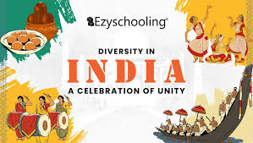

Slide 2
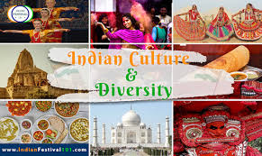
Introduction
India is home to 1.4+ billion people
28 states, 8 union territories
22 official languages, 700+ dialects
. A melting pot of traditions, beliefs, and customs

Slide 3
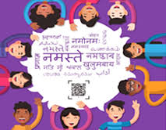
Languages
India has 22 official languages and hundreds of dialects.
Hindi and English are widely spoken.
Every region has its own language script and oral tradition.

Slide 4
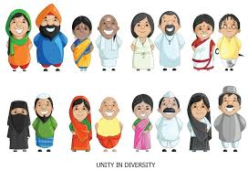
Religions
Major religions: Hinduism, Islam, Christianity, Sikhism, Buddhism, Jainism.
India is the birthplace of 4 major world religions.
Religious festivals are celebrated across communities.

Slide 5
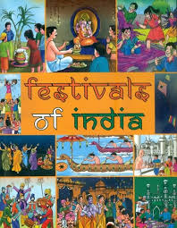
Festivals
Holi, Diwali, Eid, Christmas, Baisakhi, Pongal, Onam, and more.
Every festival reflects local traditions and regional flavors.
Promotes harmony and shared joy.

Slide 6
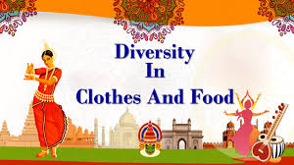
Food & Clothing
Diverse cuisines: from spicy South Indian to rich North Indian dishes.
Clothing styles vary: sarees, salwar-kameez, dhotis, kurta-pajamas, etc.
Each region has unique attire and textiles.

Slide 7
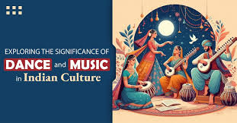
Art, Dance & Music
Classical dances: Bharatanatyam, Kathak, Odissi, Kathakali, etc.
Folk music and dances: Bhangra, Garba, Lavani, etc.
Rich tradition in paintings, handicrafts, and sculpture.

Slide 8
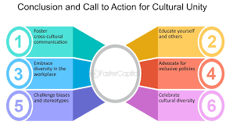
Conclusion
India’s diversity is a strength, not a division.
Cultural richness brings color and depth to the nation
True example of “Unity in Diversity.”

Slide 9


